Slide 1
Blackboard Project
Group 1
Hyeoncheol Lee
Sidney Smith
Mouhamadou Seye
Ivaylo Todorchev

Slide 2
Blackboard
Aim
Motivation
Main stories
Software process
Lead to the solution
Data models
External Resources
Working Demos
Lessons Learned

Slide 3
Aim
Implementing a “blackboard” like product
Blackboard will implement three type of users
Administrators
Instructors
Students

Slide 4
Motivation
We have all worked with Blackboard and wished that it could be better.

Slide 5
Main Stories
Administrators
Instructors
Students

Slide 6
Use cases - Administrators
Course management
- View course list
- Create courses
- View, Edit courses, Delete courses
User management
- View user list, Create user(Instructor, student) account,
- View info of user, Edit, Delete user account
- View administrator account, Edit administrator account

Slide 7
Use cases - Instructors
Course management
Course Registration management
Document(Lecture material) management
Assignment management
Exam management
Calendar management
Collaboration management

Slide 8
Use cases - Students
Course management
Course Registration management
Document(Lecture material) management
Assignment management
Exam management
Calendar management
Collaboration management

Slide 9
Software Process
We planned using stories, an ERD, and divided into four sections which assigned to team members:
User Management (Chuck)
Course Management (Mouhamadou)
Document Repository (Lee, Mouamadou)
Assignments(Lee)
Grade Book(Lee, Chcuk)
Scheduler (Lee, Mouamadou)
Collaboration (Ivaylo)
Design and Layout(Lee, Ivaylo)
Automatic Testing (Lee, Chcuk)
Mobile View(Lee, Ivaylo)
We made extensive use of Subversion to share data between team members.
Regular Group Meetings
Developing by using Microsoft .NET MVC4

Slide 10
Lead to Solution
We originally planned to implement calendaring using a mashup; however, we discovered that the use cases required it to be too tightly integrated into to the application; therefore, we used an external module Jquery Full Calendar.

Slide 11
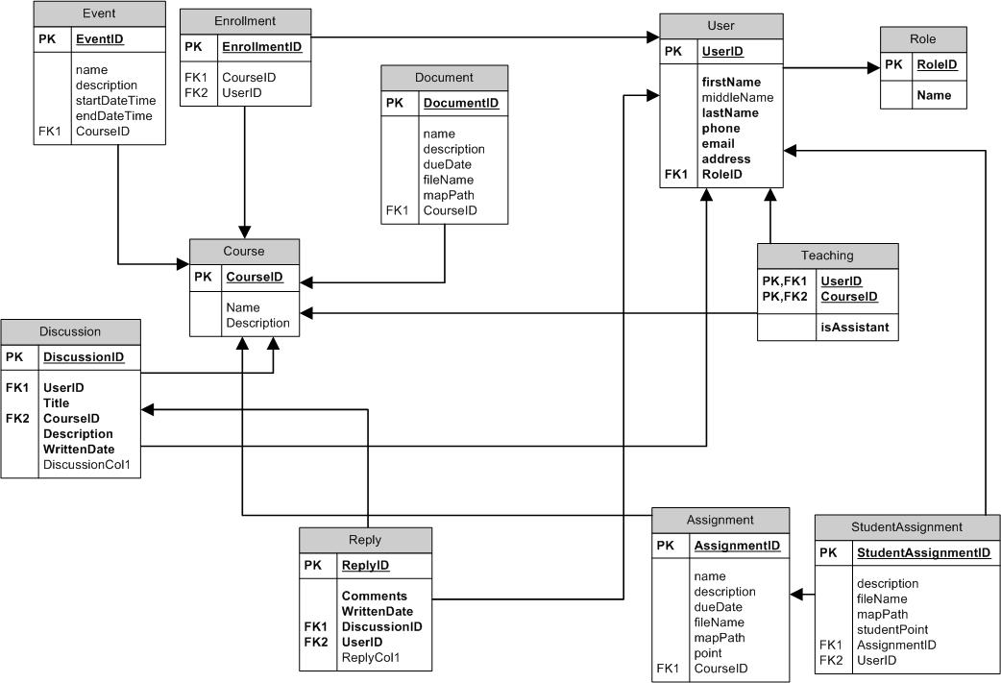
Data Model

Slide 12
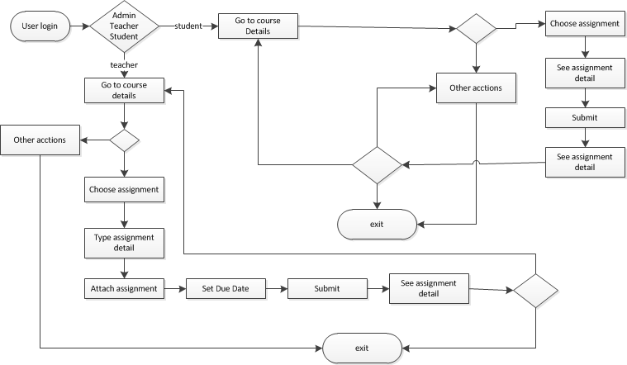
State Diagram - Assignments

Slide 13
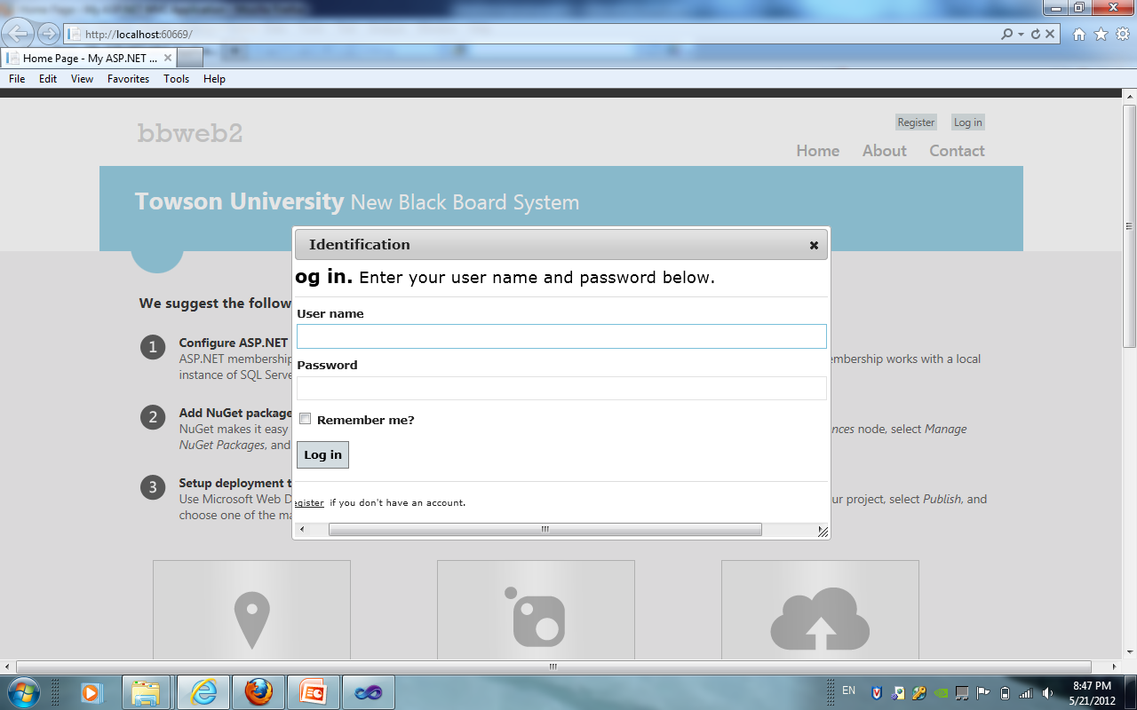
Screen Shots Create Assignments
Admin: intructor1
Pass:123456

Slide 14
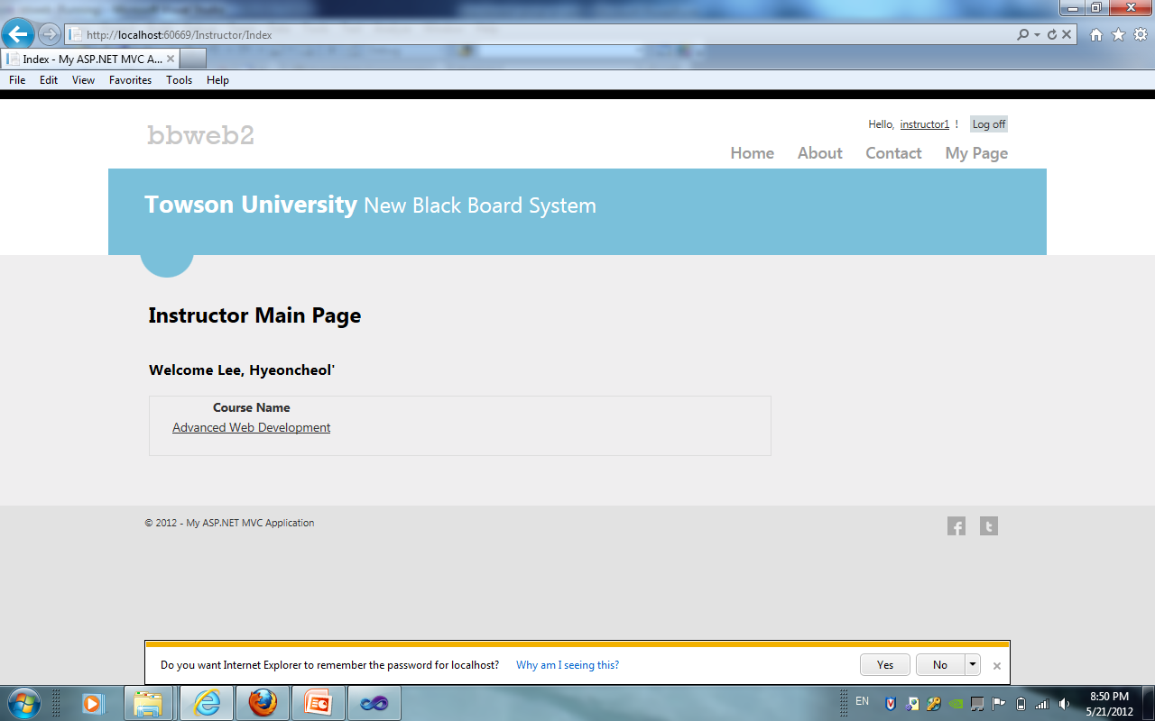
Screen Shots Create Assignments
Choose course

Slide 15
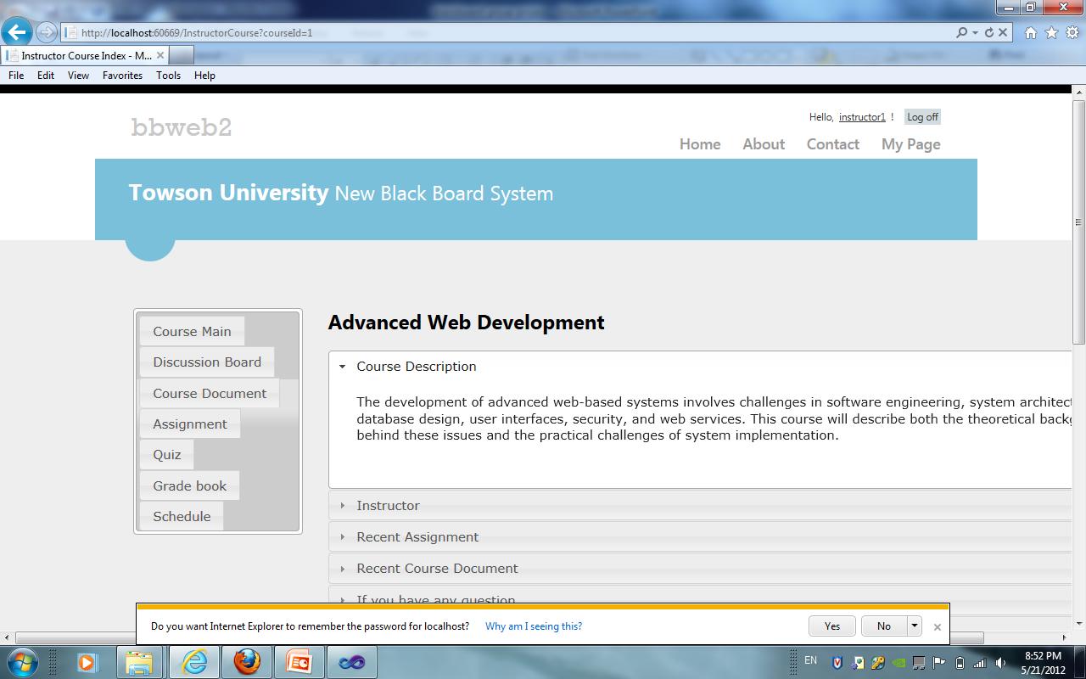
Screen Shots Create Assignments
Choose Assigment

Slide 16
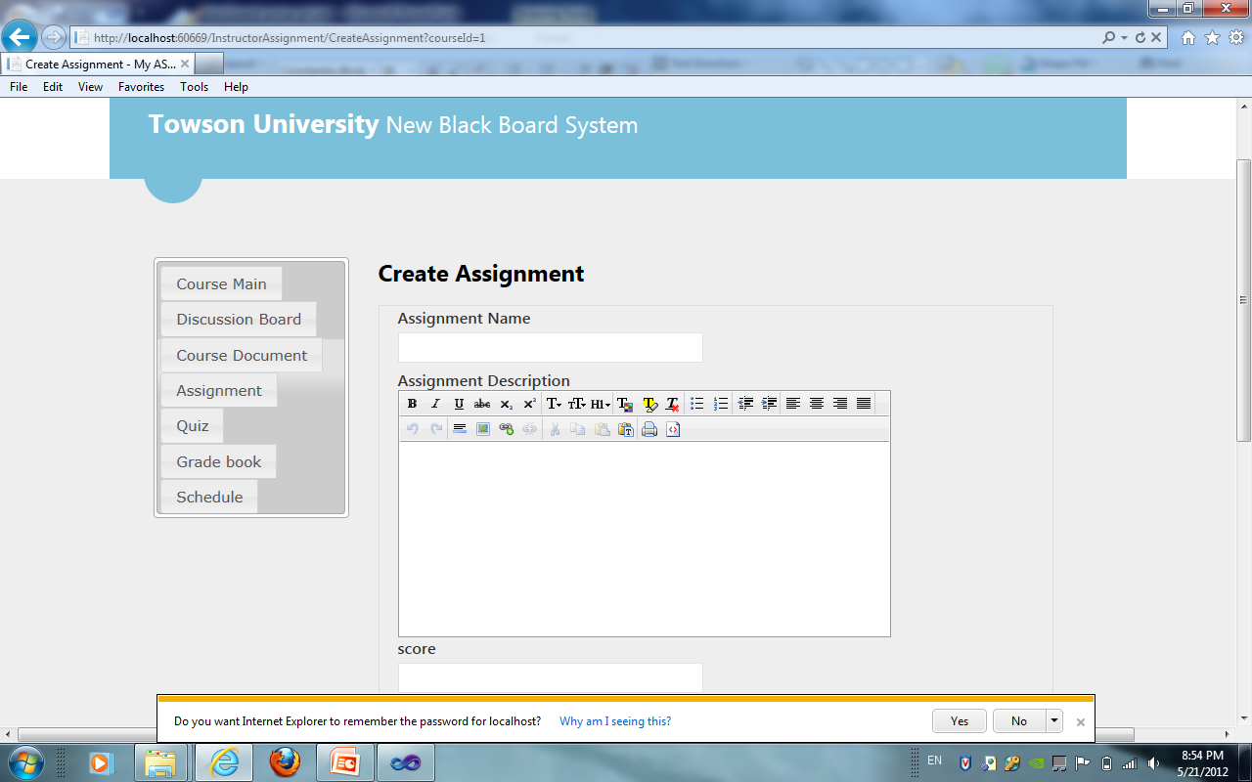
Screen Shots Create Assignments
From assignment page we can see the all assignments. We choose create an assignment. Feel up the required fields, and click submit.

Slide 17
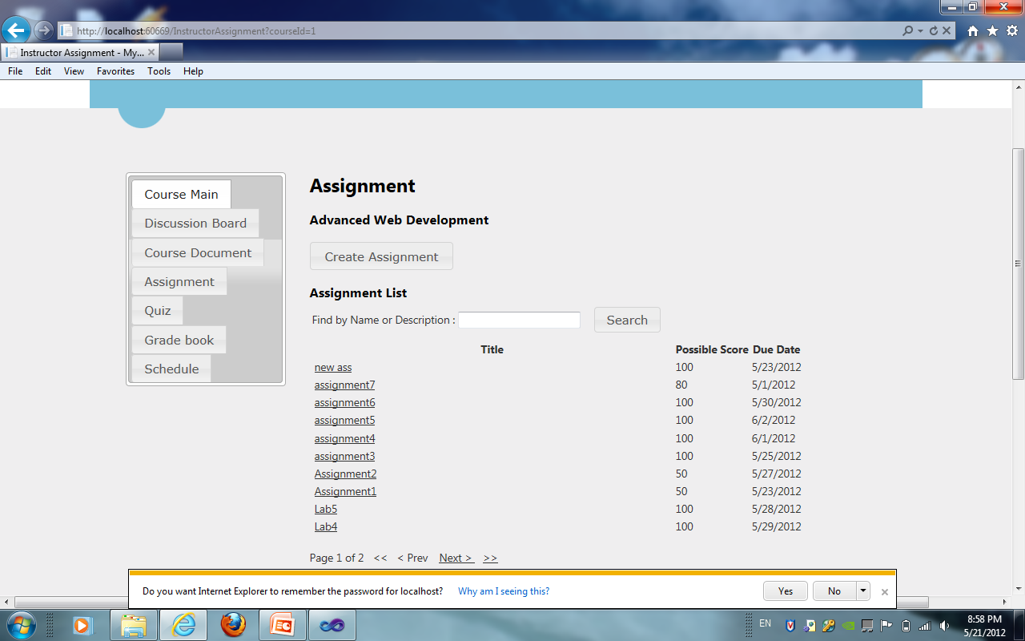
Screen Shots Create Assignments
After submission we are back to Assignment page where we can see the updated contend. By clicking on the functionalities we can perform other activities in instructor controller

Slide 18
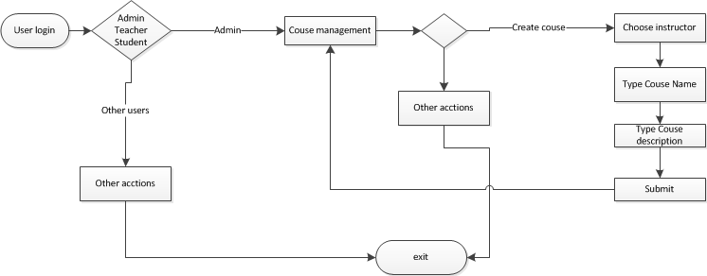
State Diagram – Create course

Slide 19
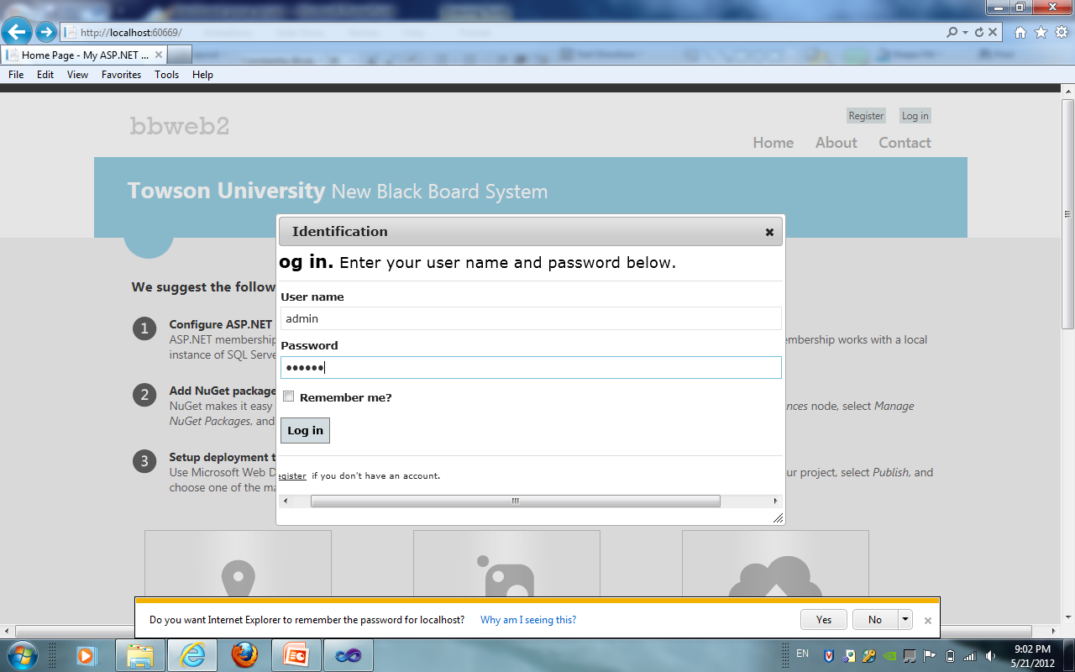
Screen Shots – Create course
Admin: admin
Pass: 123456

Slide 20
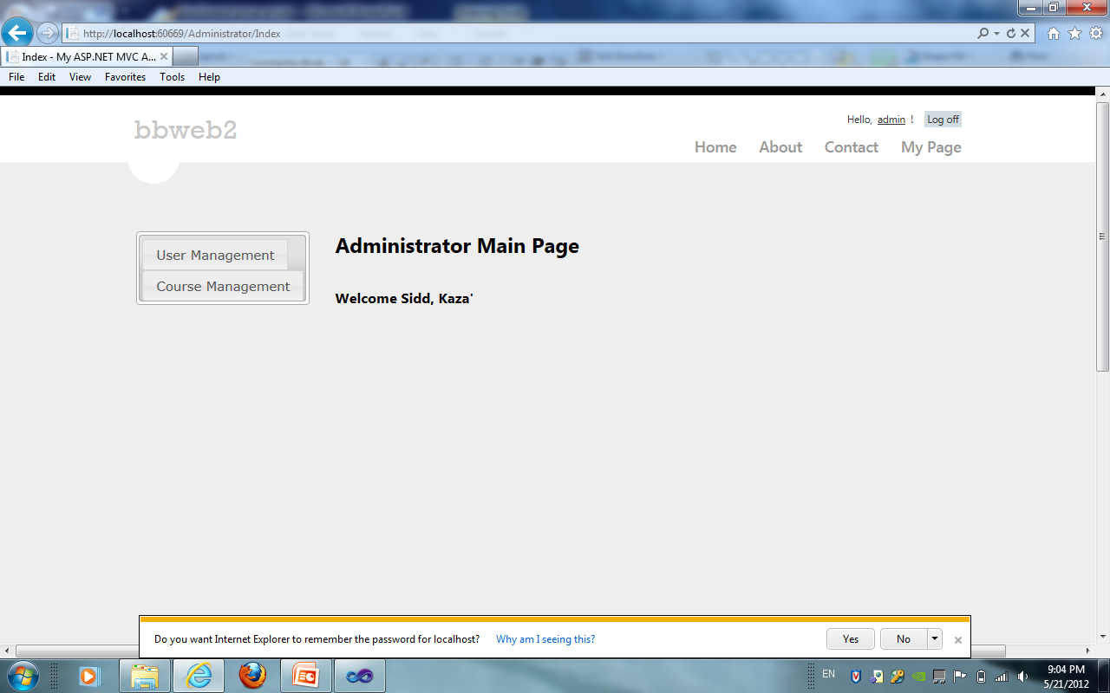
Screen Shots – Create course
After login we are at administrator page . From here we choose course management in order to create course

Slide 21
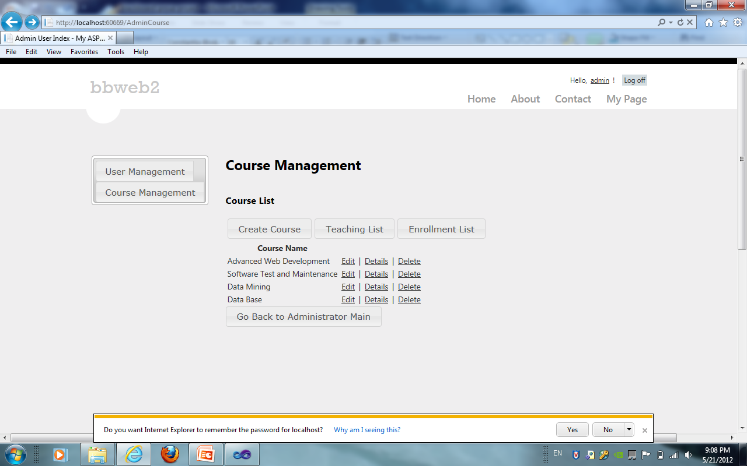
Screen Shots – Create course
From here we can see the existing courses where we cam perform Teaching list, enrollment and create course we choose to create new course

Slide 22
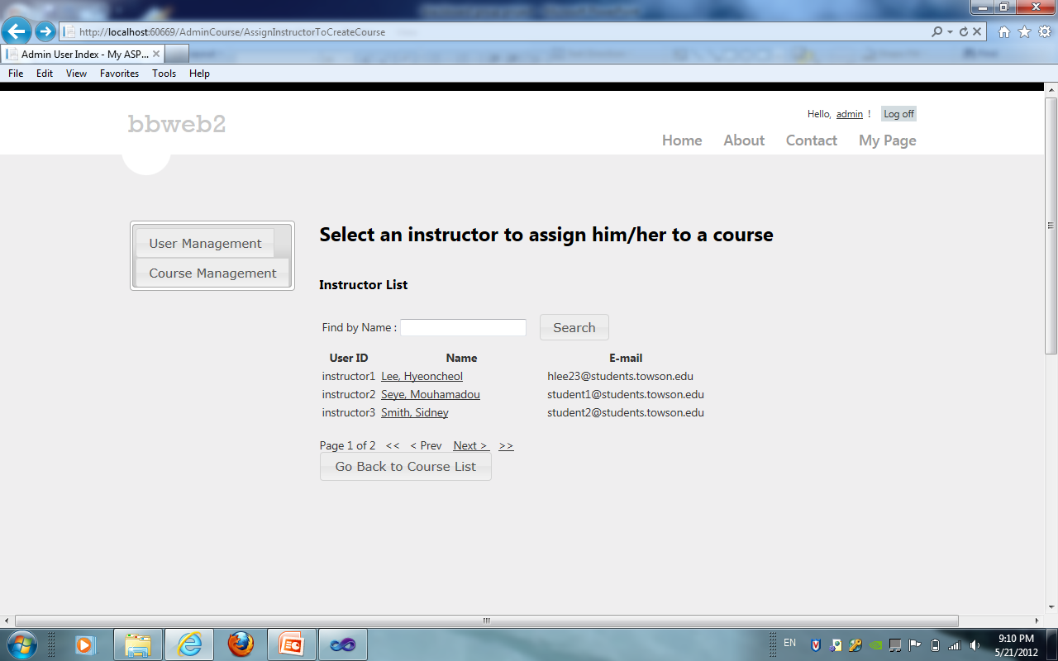
Screen Shots – Create course
In order to cerate course we have to assign a instructor to it from the available list.

Slide 23
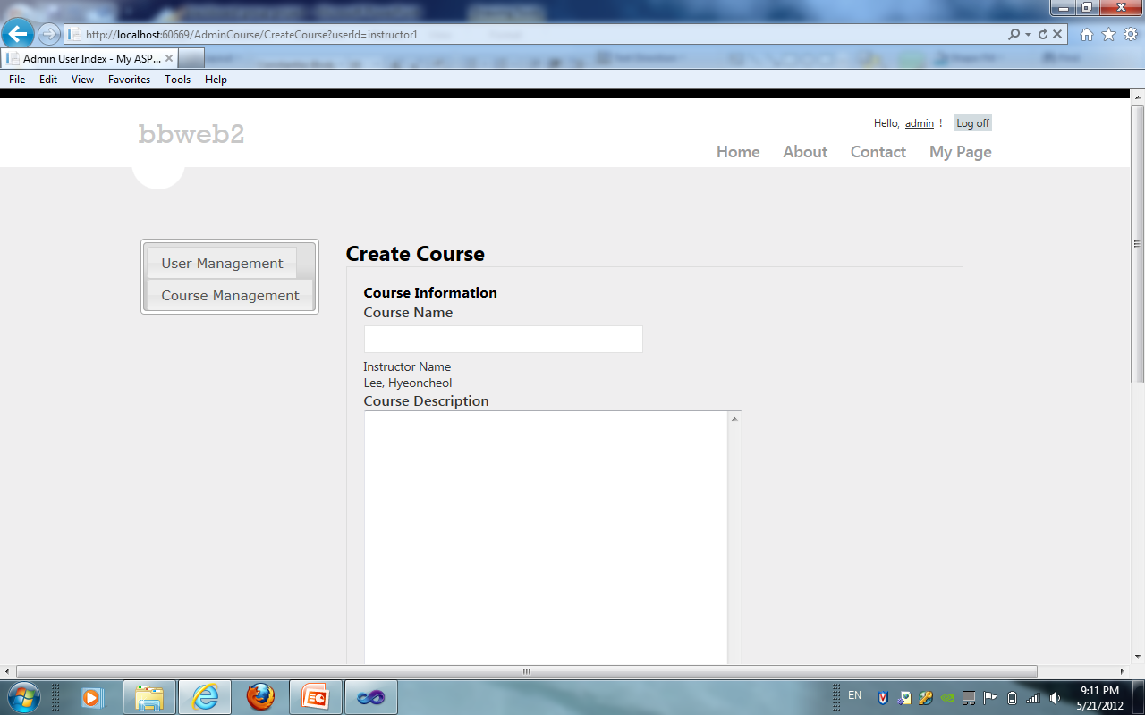
Screen Shots – Create course
After selecting a instructor we now can assign course name course description, which are required

Slide 24
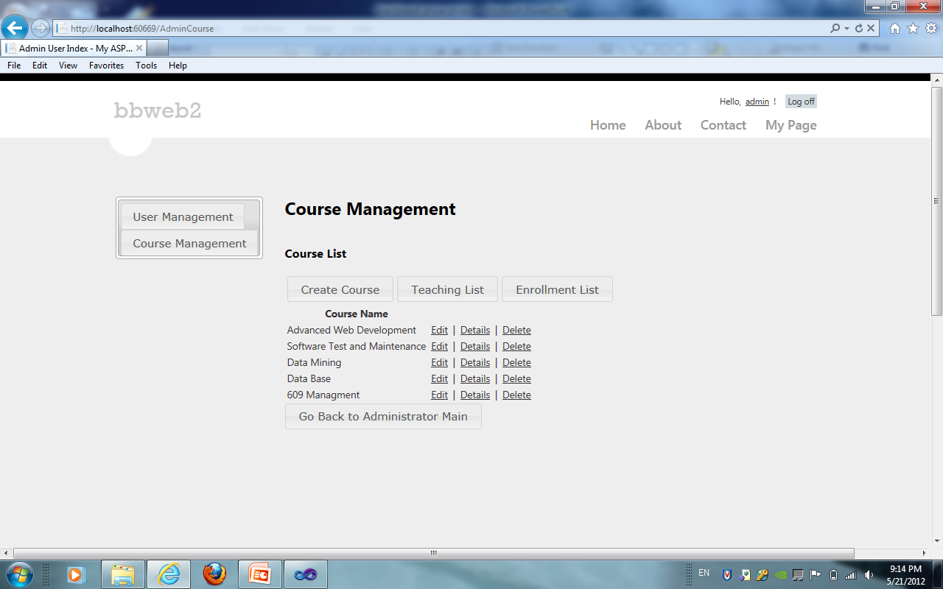
Screen Shots – Create course
By clicking submit button we are creating a new course and we are back at course management page where we can see the new course created. After that admin can perform other actions.

Slide 25
Other actions
By simply clicking on other functionality user can perform other actions similar to example above. For example create document, could see the student grades (in graph view), create discussion or reply to discussion and so on.

Slide 26
External Resources
Web Mashup - YouTube
External Module s:
Jquery Full Calendar
CLEditor
PagedList
Jquery High Charts

Slide 27
Testing and Mobile Interface
Automated Test
- Visual Studio Unit Testing (Ninject )
Mobile Interface:
- JQuery Mobile MVC

Slide 28
Working Demo

Slide 29
Lessons Learned
Necessity of a consistent tool configuration.
There are lots of external resources available.
.NET MVC4 does not employ as much magic as Ruby on Rails. Requires more explicit configuration.
Entity Frameworks compares very well to Active Record, but Entity Framework has no migrations.

Slide 30
Questions?

